Slide 1
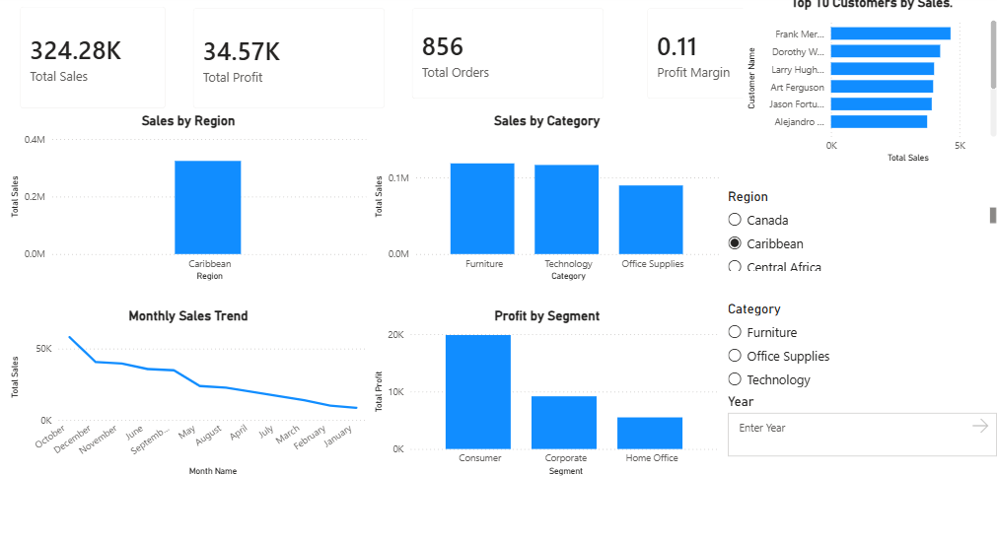
1. Executive Dashboard
The dashboard brings the main KPIs and business charts together on one page.
Main observations
The dashboard displays sales, profit, orders and profit margin.
It compares performance by region, category and customer segment.
The selected Caribbean filter means the visible KPI values are for that filtered view.

Slide 2
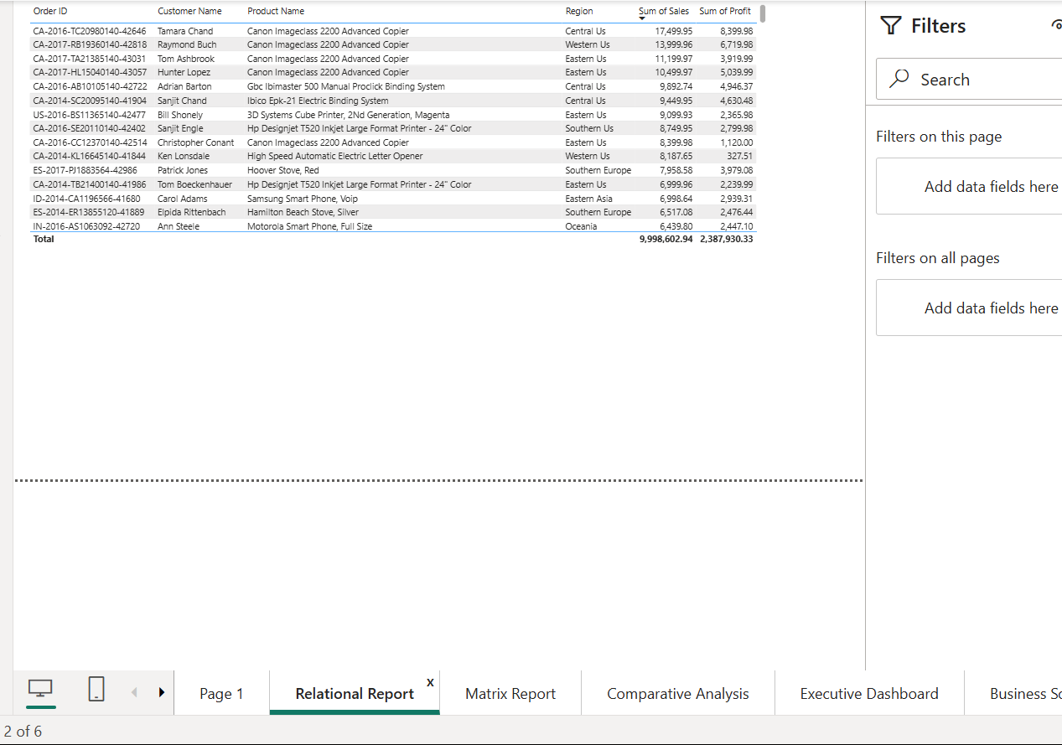
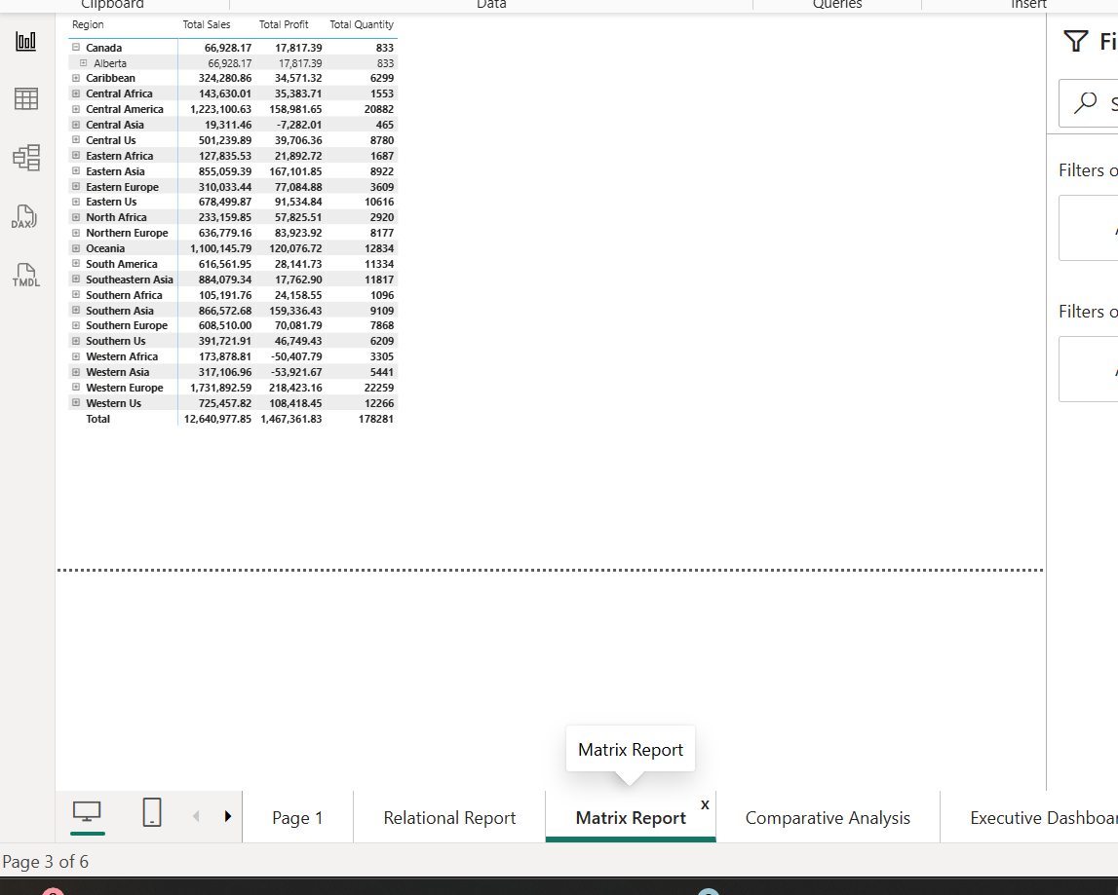
2. Transaction and Regional Reports
These two reports show the data at different levels of detail.
RELATIONAL REPORT
MATRIX REPORT
The relational report helps inspect individual orders, customers, products, sales and profit.
The matrix report summarizes sales, profit and quantity through the Region–State–City hierarchy.

Slide 3
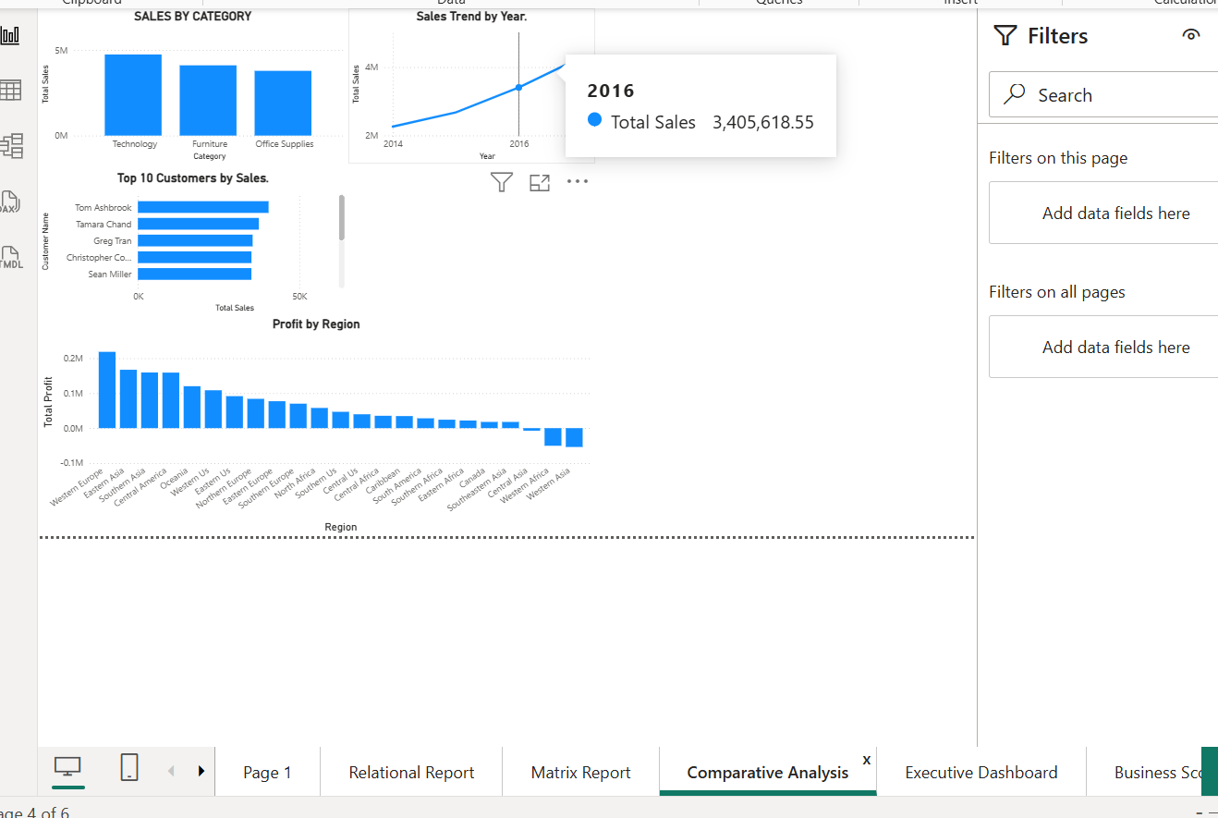
3. Comparative Analysis
The charts help compare categories, customers, regions and yearly sales.
What the charts show
Technology has the highest sales among the categories shown.
The Top 10 chart identifies customers with high sales.
The regional profit chart highlights areas that need further review.
The yearly chart shows sales movement over time.

Slide 4
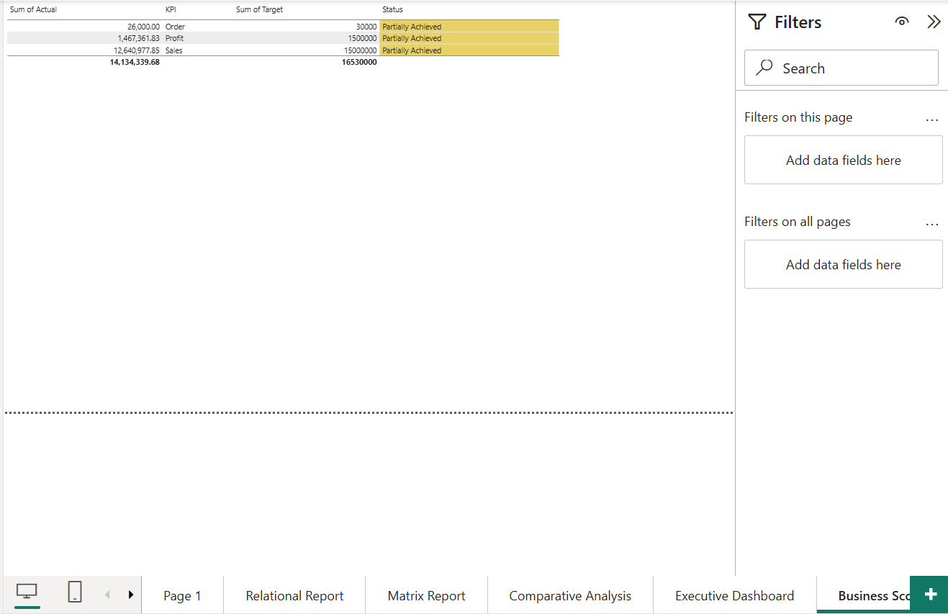
4. Business Scorecard
The scorecard compares actual performance with the targets entered for this practical.
Scorecard summary
Sales actual: 12.64M; target: 15.00M.
Profit actual: 1.47M; target: 1.50M.
Orders actual: about 26K; target: 30K.
All three indicators are marked Partially Achieved.
Targets are illustrative values used in the experiment, not verified company targets.

Slide 5
5. Findings and Recommendations
Summary based on the Power BI reports shared for this experiment.
Key findings
Recommendations
Technology and the Consumer segment are strong sales areas.
Western Europe performs strongly in sales and profit.
Western Asia and Western Africa show negative regional profit.
The scorecard targets were not fully achieved.
Review discounts, prices and delivery costs in loss-making regions.
Focus on profitable products, not only high sales.
Use customer segment results to plan suitable offers.
Check sales, profit and order targets every month.
Conclusion: The reports show where the business is doing well and where profit needs attention. Regular review of the scorecard can help management track improvements.

